Slide 1

ENVIRONEMT SCIENCE, WASTE AND DISASTER MANAGEMENT
Dr. Akriti
Assistant Professor
Department Of Civil Engineering
Chandigarh University
Gharuan, Mohali, Punjab
ENVIRONMENTAL POLLUTION AND THEIR EFFECTS
DISCOVER . LEARN . EMPOWER

Slide 2
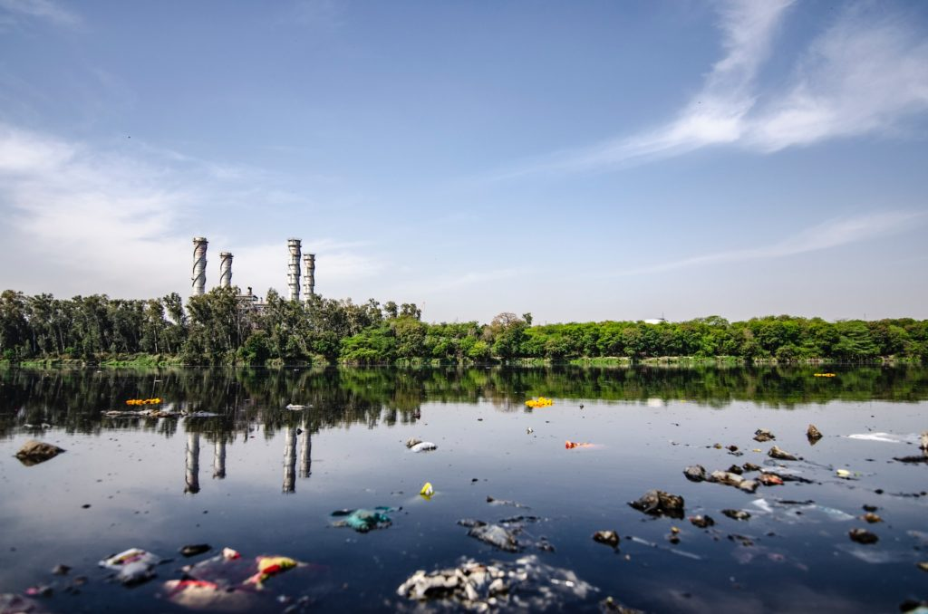

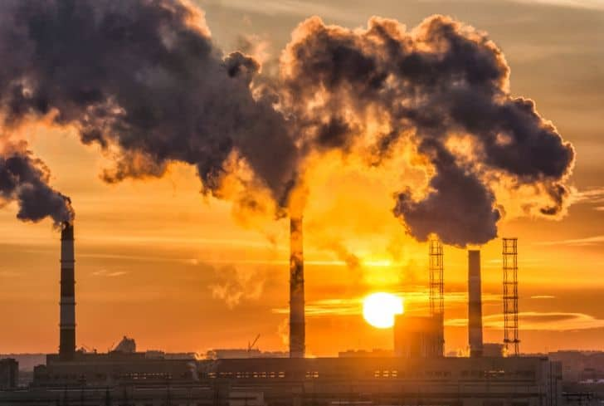
ENVIRONMENTAL POLLUTION AND THEIR EFFECTS
Course Outcome
CO Number | Title
CO1 | Understand different dimensions of environmental studies; problems related to environmental degradation & the remedial steps taken to address them.
CO2 | Understand the different types of disasters that occur in nature consequently learning to develop preparedness and remedial techniques.
CO3 | Understand the diverse problems associated with solid waste, as well as waste segregation and effective management techniques.
CO4 | Critically analyzing the roles and identities as citizens, consumers, and environmental actors in a complex, interconnected world.
CO5 | Create awareness about environmental issues and carry out outreach activities.
Google images

Slide 3
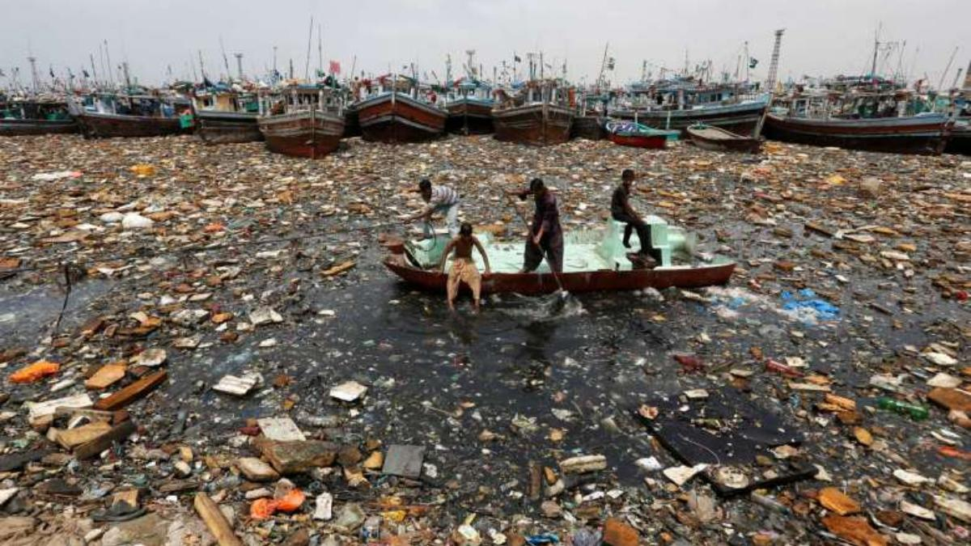
WATER POLLUTION
Addition of some substances (organic, inorganic, biological or radiological) or factor (e.g. heat) which degrades the quality of water so that it either becomes a health hazard for man, animals or plants, or unfit for use.
Types of Water Pollution
Physical pollution
Chemical pollution
Biological pollution
TYPES OF NATURAL RESOURCES

Slide 4
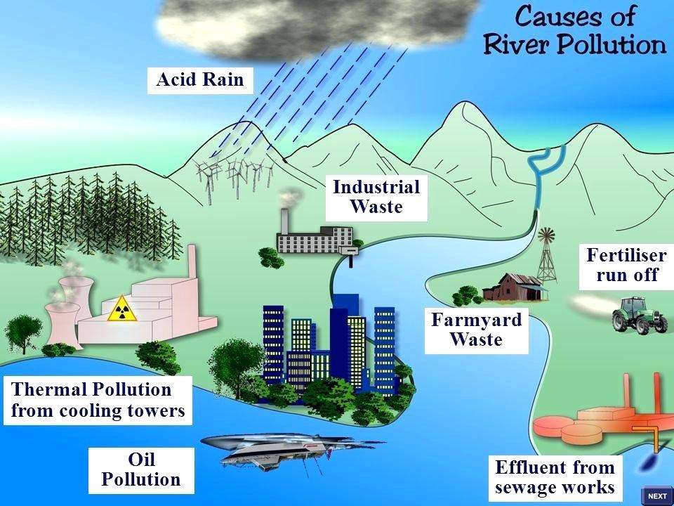
SOURCES OF WATER POLLUTION
Natural sources
Industrial sources
Domestic sources
Agricultural sources
Mining sources
Atmospheric deposition
Oil Pollution
TYPES OF NATURAL RESOURCES

Slide 5
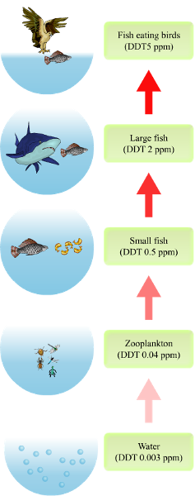
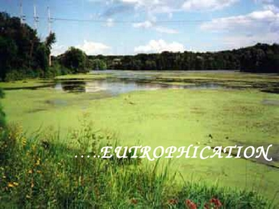
EFFECTS OR CONSEQUENCES OF WATER POLLUTION
Foul Odor
Increased turbidity
Diseases
Deterioration of quality
Blooming or Eutrophication
Biomagnification
Depletion of animal population

Slide 6
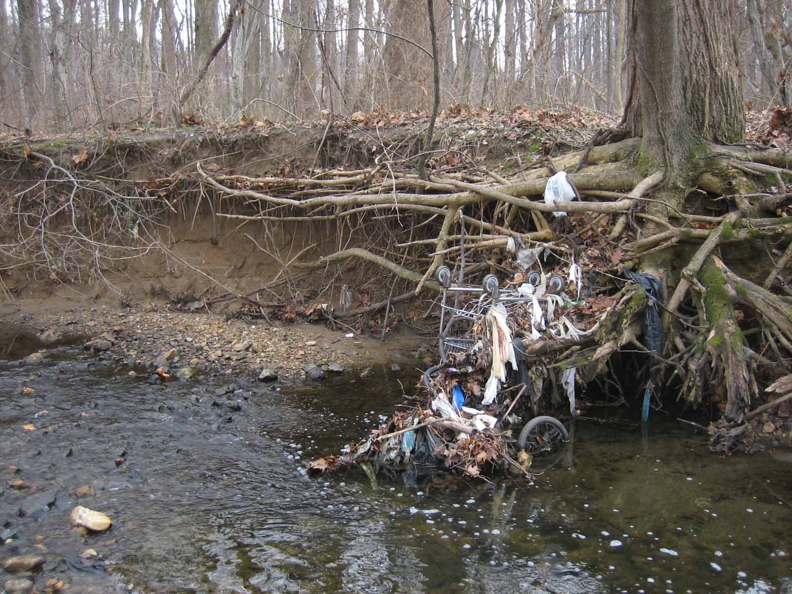
CONTROL MEASURES OF WATER POLLUTION
Effluent should not be discharged into any natural water body.
Domestic sewage shall be used for irrigation.
Industrial plants should be based on recycling operations.
Rainwater harvesting
Public awareness must be initiated regarding the adverse effects of water pollution
Laws, standards, and practices should be established to prevent water pollution and these laws should be modified from time to time
TYPES OF NATURAL RESOURCES

Slide 7
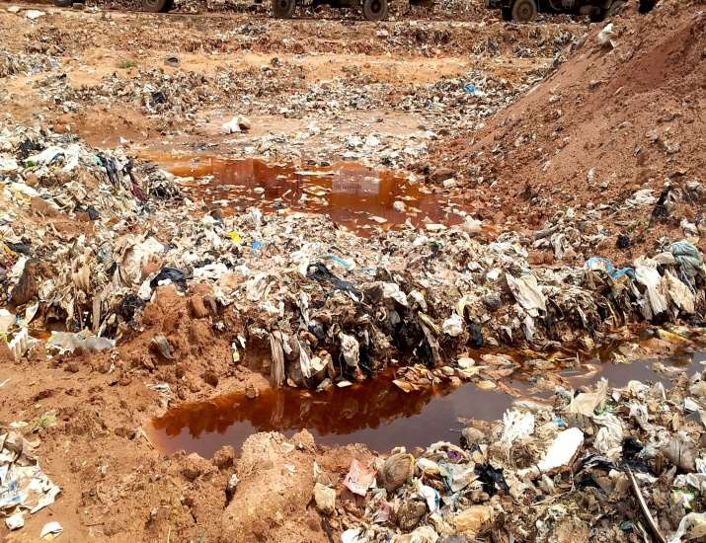
LAND POLLUTION
It can be defined as the build-up in soils of persistent toxic compounds, chemicals, salts, radioactive materials, or disease-causing agents which have adverse effects on plant growth and animal health.

Slide 8
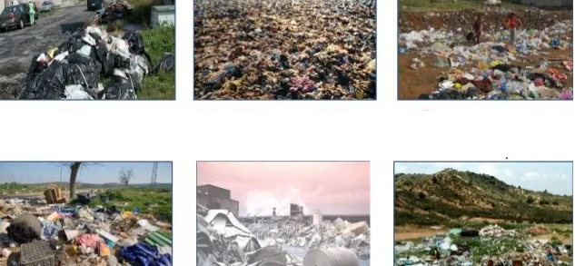
SOURCES OF LAND POLLUTION
Industrial wastes
Urban wastes
Agricultural practices
Radioactive pollutants
Miscellaneous such as acid rain, landfills, illegal dumping, mining activities, etc.

Slide 9
EFFECTS OF LAND POLLUTION
Metallic contaminants destroy bacteria and other beneficial microorganisms in soil.
Severe agricultural crop damage.
Use of polluted groundwater damages crops and may also affect both man and animals.
Excessive use of nitrate fertilizers leads to its accumulation in soil which can cause blue baby syndrome in children.
Pesticides adhere to soil particles causing harm to vegetation.
Radioactive wastes affect soil fertility.
TYPES OF NATURAL RESOURCES

Slide 10
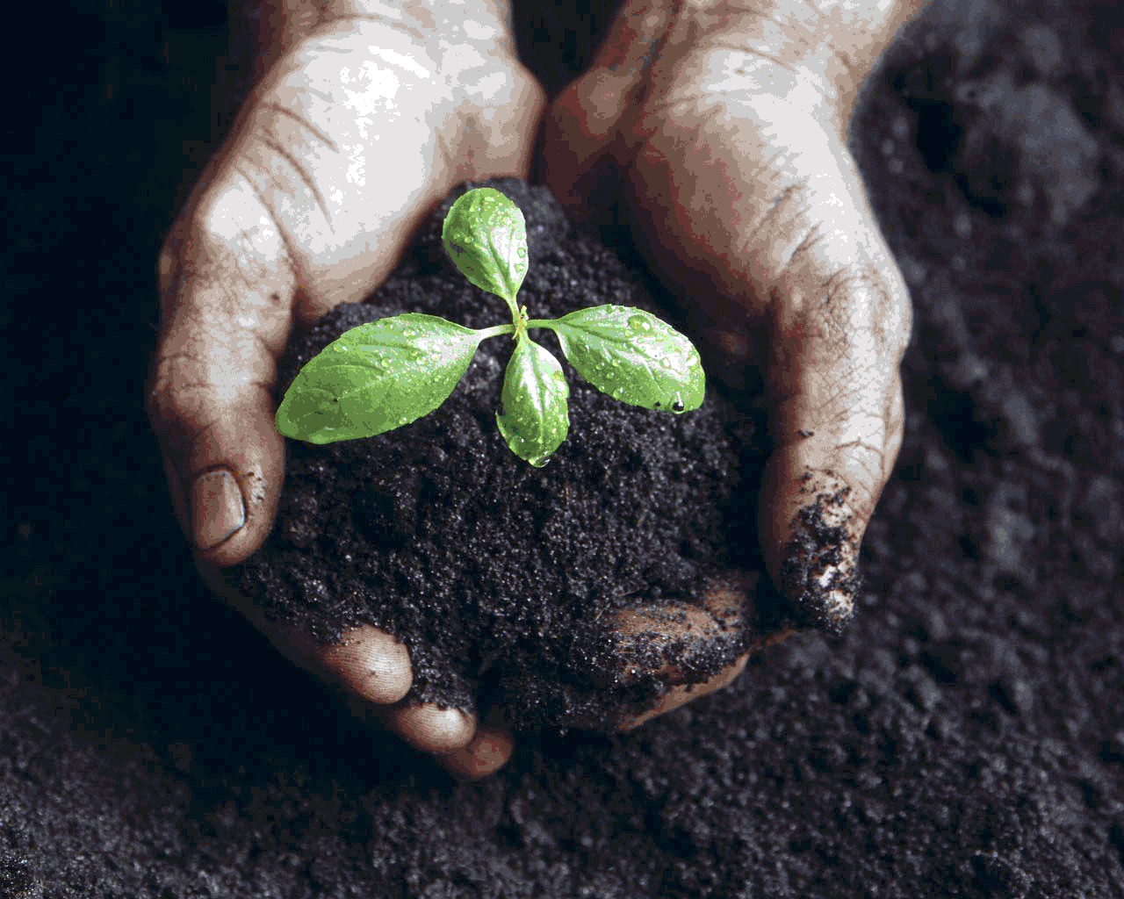
CONTROL MEASURES FOR LAND POLLUTION
Minimizing the generation of wastes
Proper dumping of unwanted materials
Recycling and reusing of wastes
Minimizing the use of agrochemicals
Production of natural fertilizers
Industrial wastes should be treated before dumping into the soil
Use of soil microorganisms to increase crop fertility
Ban to toxic chemicals
Organic farming should be adopted
TYPES OF NATURAL RESOURCES

Slide 11
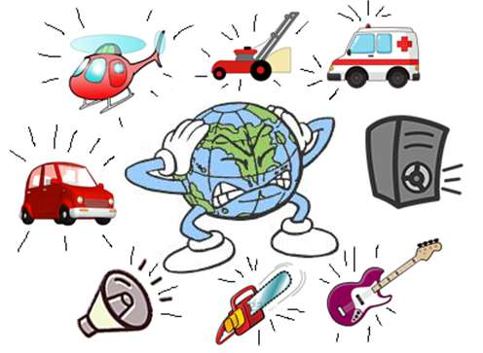
NOISE POLLUTION
Unwanted, unpleasant or disagreeable sound that causes discomfort.
Noise is subjective in nature which means a particular sound may be musical to one but noise to another.
Sources of Noise Pollution:
Industrial noise
Transport noise
Neighborhood noise
TYPES OF NATURAL RESOURCES

Slide 12
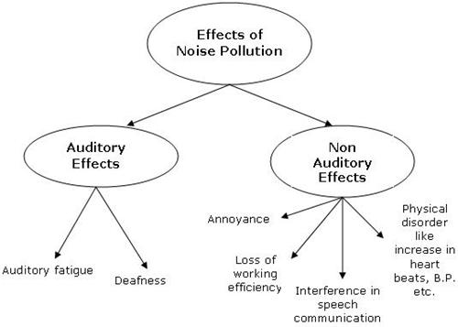
EFFECTS OF NOISE POLLUTION

Slide 13

MEASURES FOR NOISE POLLUTION CONTROL
Restricting the use of loudspeakers and amplifiers.
Setting up of industrial units far away from the residential areas.
Using well-designed and proper engines which produce less noise.
Proper lubrication and maintenance of machines.
Enforcing laws to get rid of noise-producing vehicles.
Using acoustic materials which absorb the sound.
Planting trees on both sides of roads.
Using cotton plugs, ear plugs.
TYPES OF NATURAL RESOURCES

Slide 14
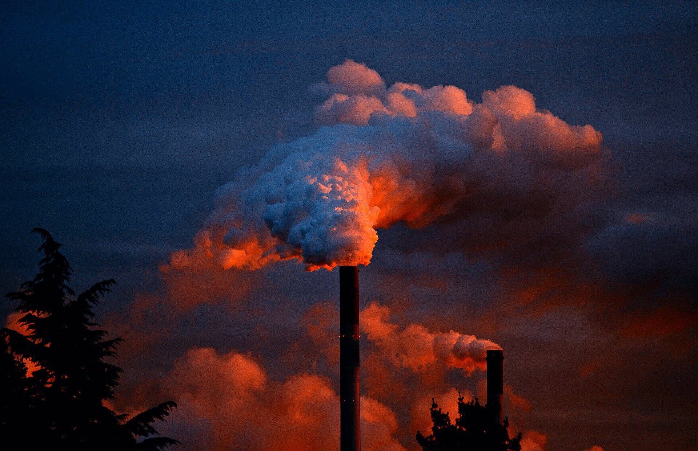
AIR POLLUTION
Occurrence or addition of foreign particles, gases or other pollutants into the air which are harmful to man, plants, animals, buildings etc

Slide 15
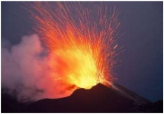
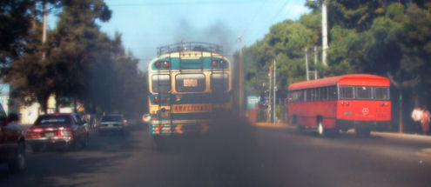
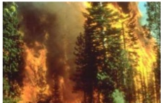
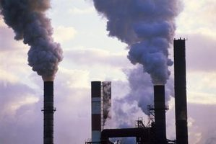
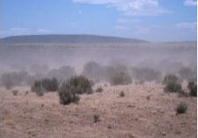
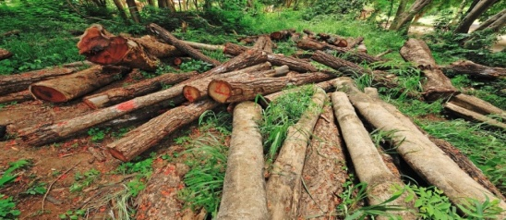
SOURCES OF AIR POLLUTION
NATURAL SOURCES-
Volcanic eruptions
Forest fires
Storms
Flowering plants
ANTHROPOGENIC SOURCES-
Domestic activities
Industries
Automobiles/ Vehicles
Agricultural activities
Mining activities
Wars and Nuclear device testing
Deforestation

Slide 16
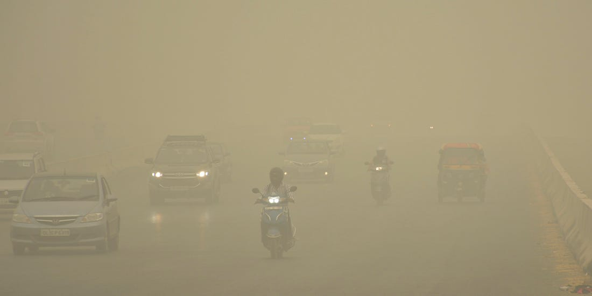
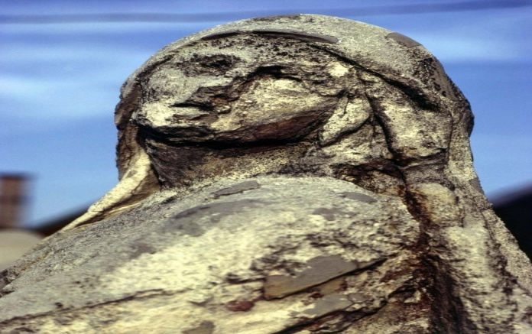
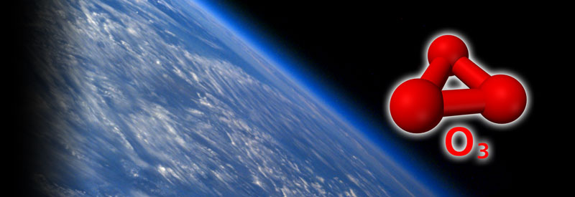
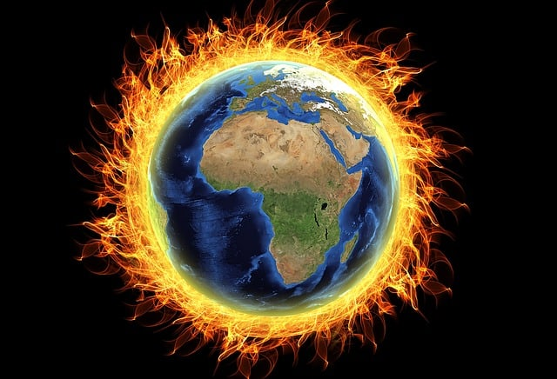
ENVIRONMENTAL IMPACTS OF AIR POLLUTION
SMOG FORMATION
ACID RAIN
Ozone Layer Depletion
Global Warming

Slide 17
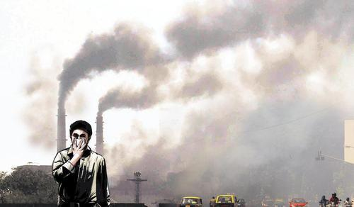
MEASURES TO CONTROL AIR POLLUTION
Reduce Vehicle Use: Use public transportation, carpool, bike, or walk whenever possible to reduce vehicle emissions.
Use Cleaner Transportation: Choose electric or hybrid vehicles, or vehicles with better fuel efficiency. Maintain your vehicle properly to minimize emissions.
Conserve Energy: Use energy-efficient appliances, turn off lights when not in use, and reduce overall energy consumption to decrease power plant emissions.
Avoid Burning: Avoid burning leaves, trash, and other materials, as this releases harmful pollutants into the air.
Support Clean Energy: Invest in solar panels, wind turbines, or other clean energy sources for your home.
Raise Awareness: Organize community campaigns to educate residents about the causes and effects of air pollution and ways to reduce it.
TYPES OF NATURAL RESOURCES

